Slide 1


Team Progress Report
Team 2
B11002012 黃昀台
B11002029 莊凱喬
B11002222 林冠羽
Copyright © 2023. All rights reserved.
1
The data and material contained in this file is copyrighted.
Please do not use without the author’s permission.
Notes:
Hello everyone. This is the presentation from Group 2. Our team members include 黃昀台、莊凱喬、林冠羽. I’m 莊凱喬。

Slide 2
Outline
System Architecture
Function or Feature
Expected Additions
Problems encountered and How to solve
Work Distribution Table
Timeline
Reference
Copyright © 2023. All rights reserved.
2
The data and material contained in this file is copyrighted.
Please do not use without the author’s permission.
Notes:
This is the outline for our presentation today, where we'll be introducing how we implemented the live streaming platform.
First, we'll talk about the system architecture we used.
Then, we'll mention some of the protocols or tools we utilized and how we plan to implement it.
Next, we’ll discuss the additional features we hope to add in the future, as well as the challenges we are currently facing.
Lastly, we'll cover the work distribution within our group and our future timeline.

Slide 3
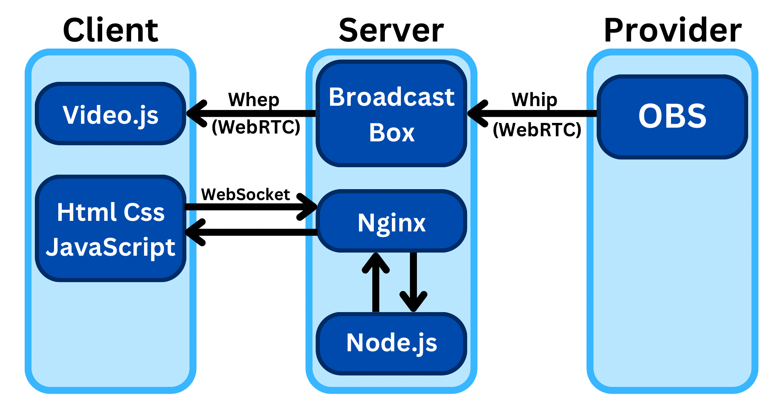
System Architecture
Copyright © 2023. All rights reserved.
3
The data and material contained in this file is copyrighted.
Please do not use without the author’s permission.
Notes:
So, this is the architecture our team uses for the live streaming platform.
Compared to the last progress report, we've made some slight adjustments
First off, the client communicates with Node.js through Socket.io. (Socket.io就是實現WebSocket)
Secondly, Nginx plays a crucial role in handling SSL encryption and acts as a reverse proxy, also providing static data like scripts. For instance, Socket.io needs to provide the client-side script, or else the client won't be able to communicate with the server.
Thirdly, OBS uploads to the broadcast box through Whip, and the client then downloads through Whep.

Slide 4


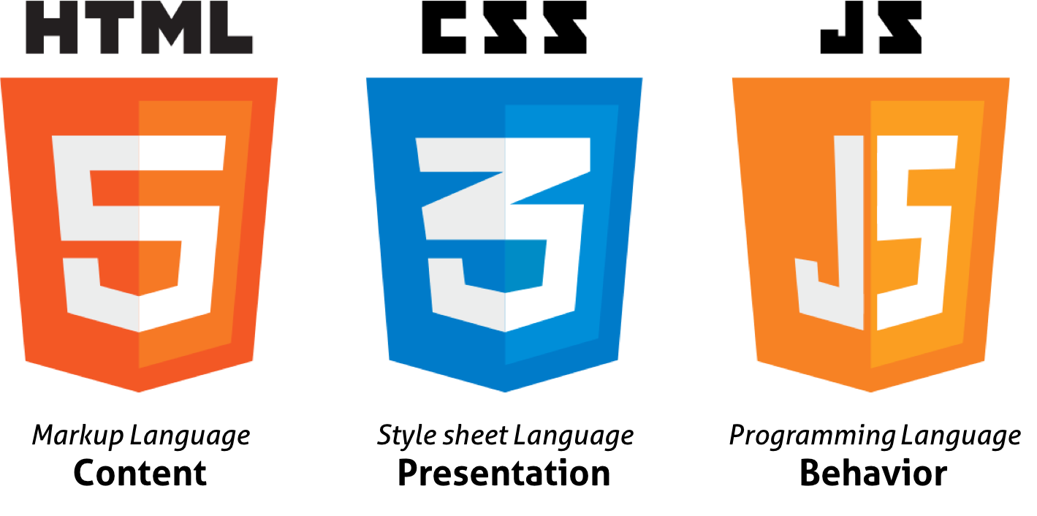
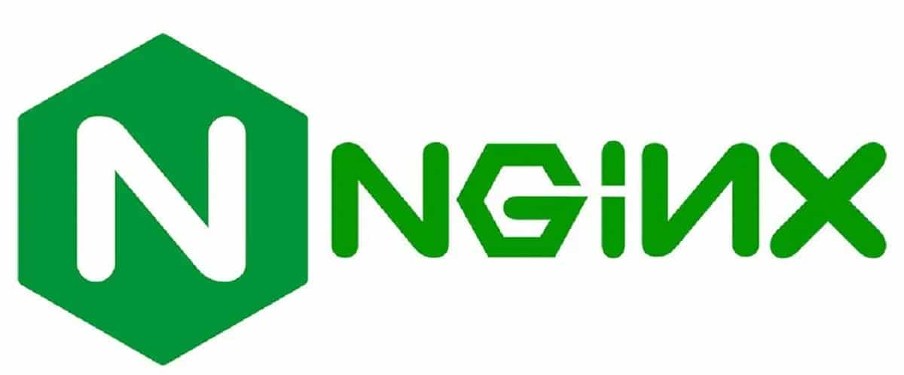
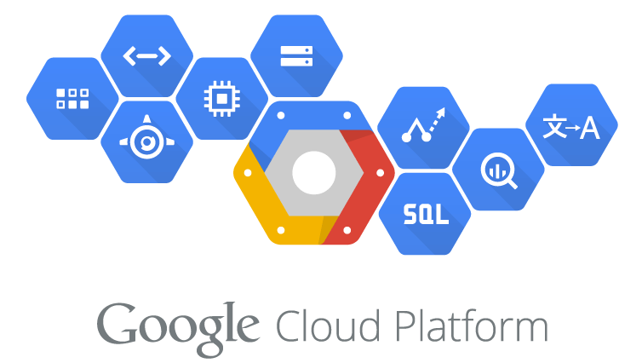

Function and Feature
How did we establish our live streaming platform?
HTML、CSS、JavaScript
GCP
Nginx
Node.js
Socket.io(Websocket)
WebRTC
Copyright © 2023. All rights reserved.
4
The data and material contained in this file is copyrighted.
Please do not use without the author’s permission.
Notes:
We used HTML, CSS, JavaScript, Google Cloud Platform (GCP), Nginx, Socket.IO, Node.js, and WebRTC to build our live streaming platform.

Slide 5
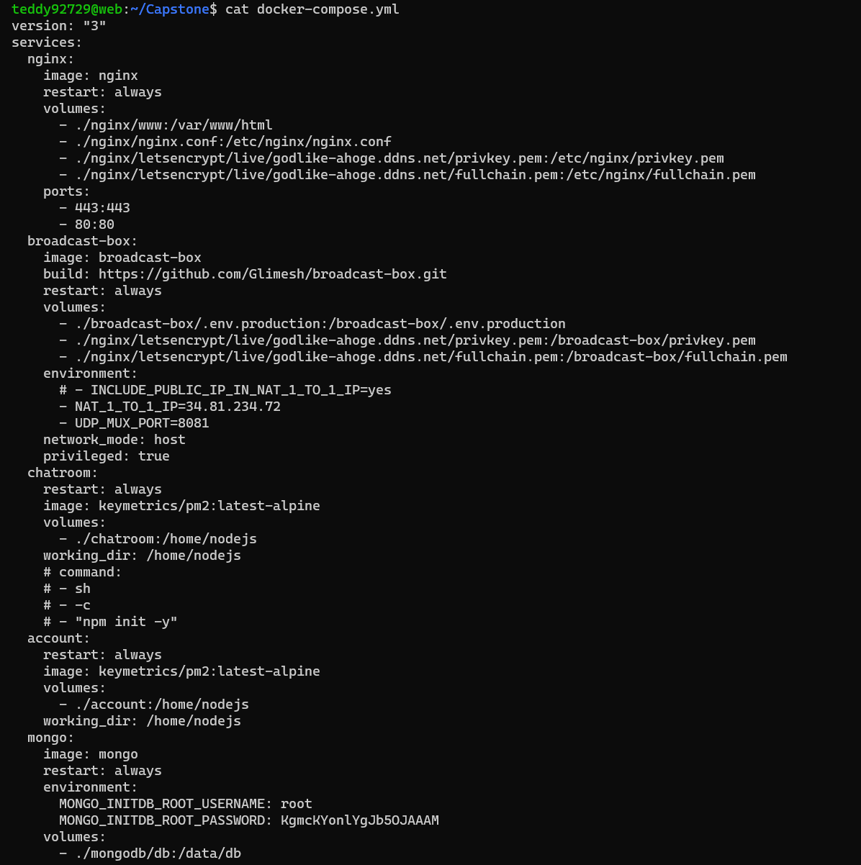
Function and Feature
Docker
Nginx
Broadcast Box
Node.js
MongoDB
Copyright © 2023. All rights reserved.
5
The data and material contained in this file is copyrighted.
Please do not use without the author’s permission.
Notes:
By using Docker to manage services, our system includes Nginx, Broadcast Box, Node.js, and MongoDB.

Slide 6
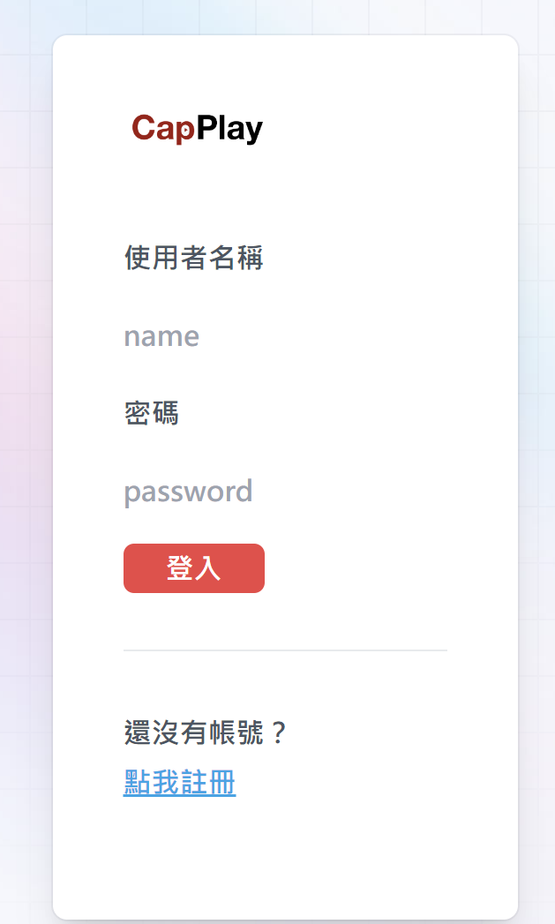
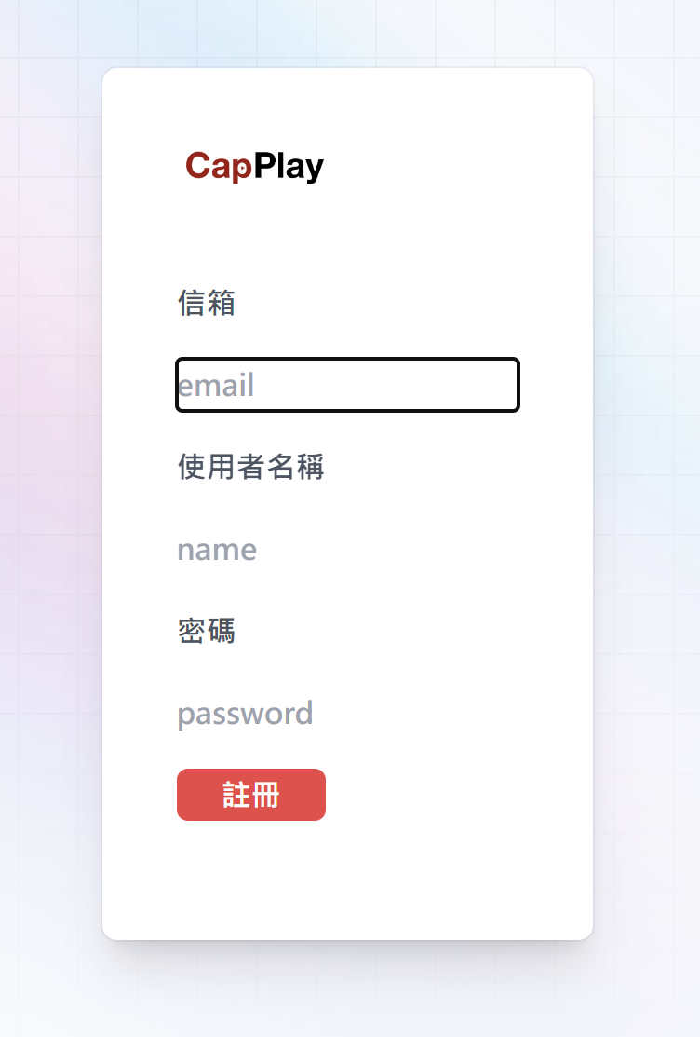
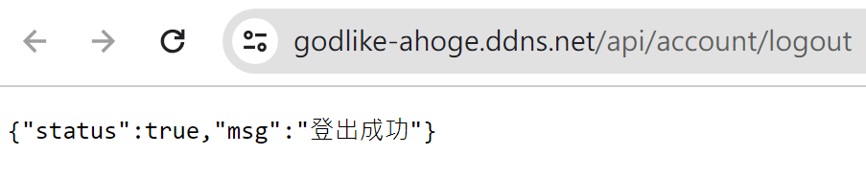
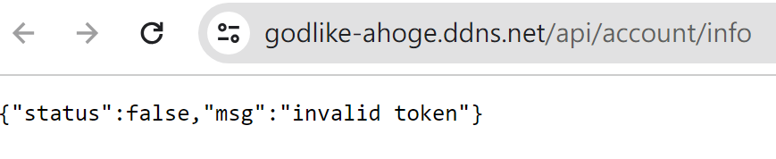
Login & RegistrationSystem UI
Copyright © 2023. All rights reserved.
6
The data and material contained in this file is copyrighted.
Please do not use without the author’s permission.
Notes:
This is our login and registration User interface. The image in the top-left corner represents the login page, while the image in the top-right corner represents the registration page. Additionally, it is possible to log out or obtain account information through the API.

Slide 7
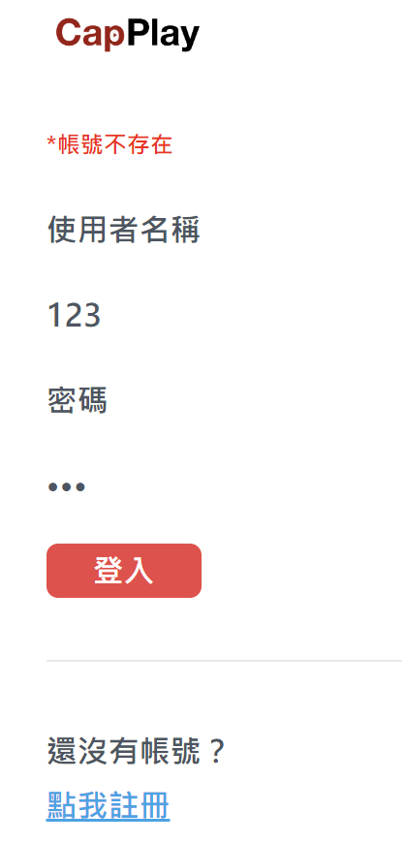
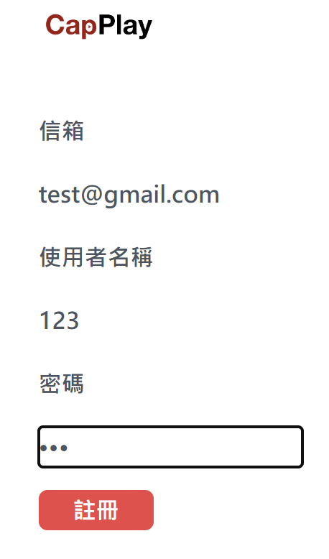
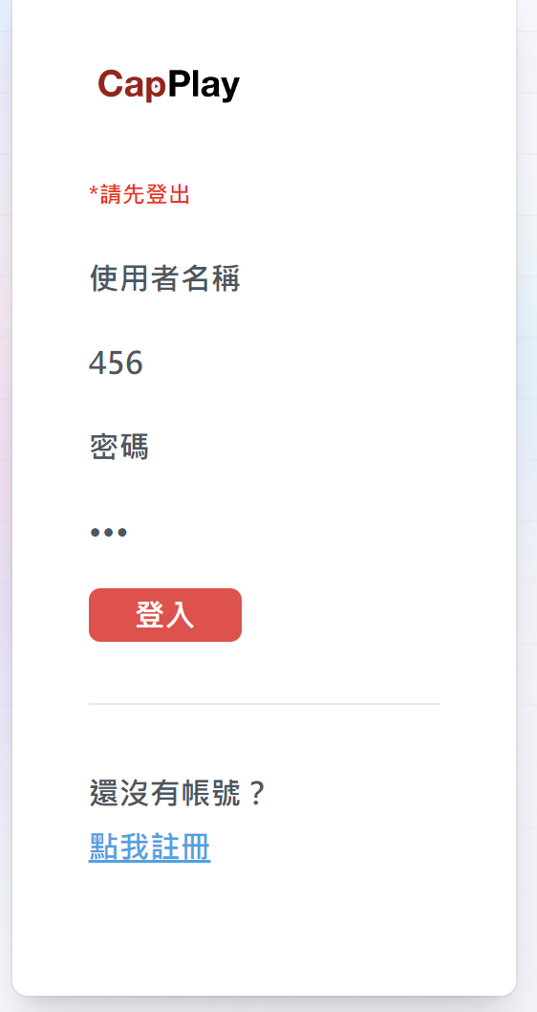
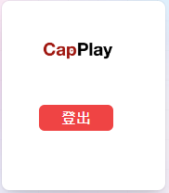
Login & RegistrationSystem UI
Copyright © 2023. All rights reserved.
7
The data and material contained in this file is copyrighted.
Please do not use without the author’s permission.
Notes:
During login, the system checks whether the account exists and if the password is correct. If there is an error, a red prompt will be displayed. Upon successful login, the browser will write a cookie to maintain the login status. Additionally, as shown in the picture below, the API will display the relevant data.

Slide 8
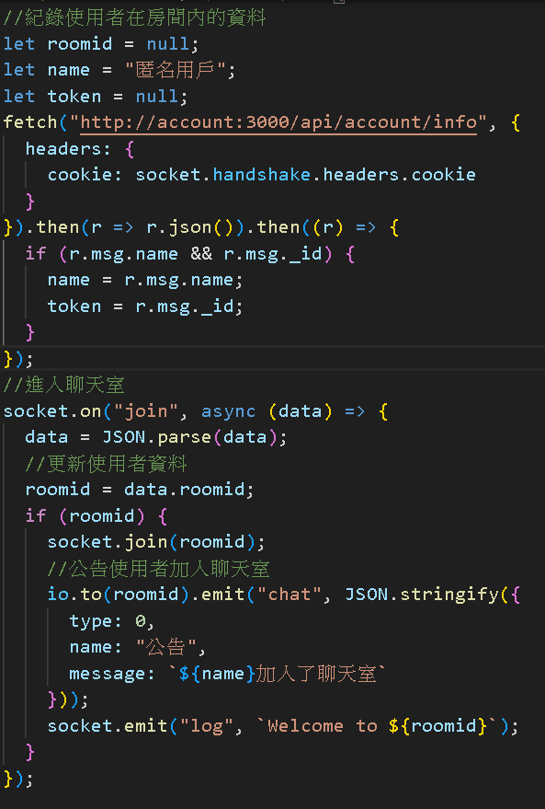
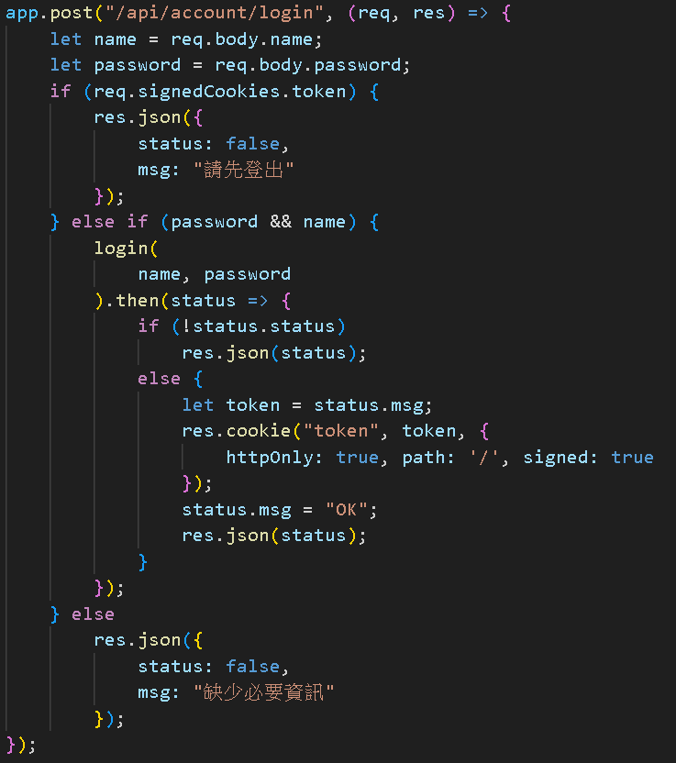
左邊是登錄
右邊是聊天室
Copyright © 2023. All rights reserved.
8
The data and material contained in this file is copyrighted.
Please do not use without the author’s permission.
Notes:
The image on the left depicts the implementation of the login system, while the image on the right illustrates the implementation of the chat room.

Slide 9
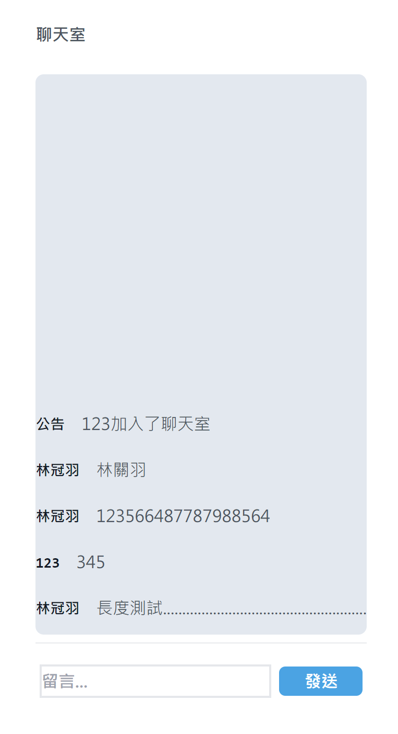
Expected Additions
✅
Before entering the room, both the audience and the streamer can create a unique account or opt for a guest login.
There is a chat room available.
The system incorporates a profanity filter, resulting in the banning of participants using inappropriate language.
Within the room, the streamer has the discretion to permit or restrict the audience's camera and microphone for interaction.
✅
✅
🔜
Copyright © 2023. All rights reserved.
9
The data and material contained in this file is copyrighted.
Please do not use without the author’s permission.
Notes:
The first three expected features have been successfully implemented.
Our first additional feature is a login function, which allows viewers and streamers to create their own accounts to use our website.
We'll have a chat room for live streaming and comments. And steamers can change the permissions of each viewer Also we’ll make a profanity filter ,which delete inappropriate language to make our environment more positive and friendly. Just like YouTube or Twitch.

Slide 10

Expected Additions
You can send gifts or donations to the streamer, and in return, enjoy super messages (Bullet screen + sound effects).
The platform records real-time participation, peak viewership, and historical views of the live stream.
The ultimate goal is to enable the streamer to change their voice and appearance, just like a Vtuber.
🔜
🔜
🔜
Copyright © 2023. All rights reserved.
10
The data and material contained in this file is copyrighted.
Please do not use without the author’s permission.
Notes:
The remaining content is still in progress.
As an audience, you can donate to the steamer, and a super message will appear on the screen.
Our platform records three important information of live streaming, real-time participation, peak viewership, and historical views.

Slide 11
What kind of problems we met and how did we fix it?
The server lacks a domain name and cannot use HTTPS. We use “no-ip” to convert an IP location to a domain name and “Let's Encrypt” to apply for an SSL certificate.
The latency using RTMP is too high, prompting us to find other ways to improve it. We researched low-latency live streaming and discovered that WebRTC is a suitable solution for us.
Copyright © 2023. All rights reserved.
11
The data and material contained in this file is copyrighted.
Please do not use without the author’s permission.
Notes:
The server lacks a domain name and cannot use HTTPS. We use “no-ip” to convert an IP location to a domain name and “Let's Encrypt” to apply for an SSL certificate.
The latency using RTMP is too high, prompting us to find other ways to improve it. We researched low-latency live streaming and discovered that WebRTC is a suitable solution for us.
Currently, we are encountering minor issues, but they are generally manageable, and the development is proceeding smoothly.

Slide 12
Work Distribution Table
黃昀台：live streaming part / data base (backend )
莊凱喬：live streaming part / user interface (frontend)/ slides/ oral presentation
林冠羽：chatroom part / Beautify and embellish (frontend)
Copyright © 2023. All rights reserved.
12
The data and material contained in this file is copyrighted.
Please do not use without the author’s permission.
Notes:
This is the work Distribution Table for our team.

Slide 13






Timeline
Week 4&5
Discuss work items
Week 8
Progress Report
Week 12
Progress Report
Week 14
Depending on the progress
Week 10
Chatroom
Week 6&7
Replace RTMP with WebRTC
Week 9
Live streaming
Week 11
Database for login function
Week 13
Super message
Week 15&16
Final Demo &
Final Document
Copyright © 2023. All rights reserved.
13
The data and material contained in this file is copyrighted.
Please do not use without the author’s permission.
Notes:
This is our timeline. So far, the basic streaming service has been completed, with additional features remaining.

Slide 14
Reference
https://github.com/arut/nginx-rtmp-module/
https://github.com/twtrubiks/nginx-rtmp-tutorial
https://super000999888.medium.com/%E4%BD%BF%E7%94%A8%E8%80%85%E8%AA%8D%E8%AD%89%E7%B3%BB%E7%B5%B1%E5%AF%A6%E4%BD%9C-node-js-%E4%B8%8A-28195a43ee68
https://github.com/CoSMoSoftware/OBS-studio-webrtc/releases
https://en.wikipedia.org/wiki/Google_Cloud_Platform
https://en.wikipedia.org/wiki/Nginx
https://en.wikipedia.org/wiki/Socket.IO
https://en.wikipedia.org/wiki/Node.js
https://en.wikipedia.org/wiki/WebRTC
https://en.wikipedia.org/wiki/WebSocket
https://www.japaholic.com/tw/article/detail/913615
https://www.twitch.tv/
https://stackoverflow.com/questions/69106977/nodejs-socketio-peerjs-a-simple-code-not-working
Copyright © 2023. All rights reserved.
14
The data and material contained in this file is copyrighted.
Please do not use without the author’s permission.

Slide 15

Q&A

Slide 16
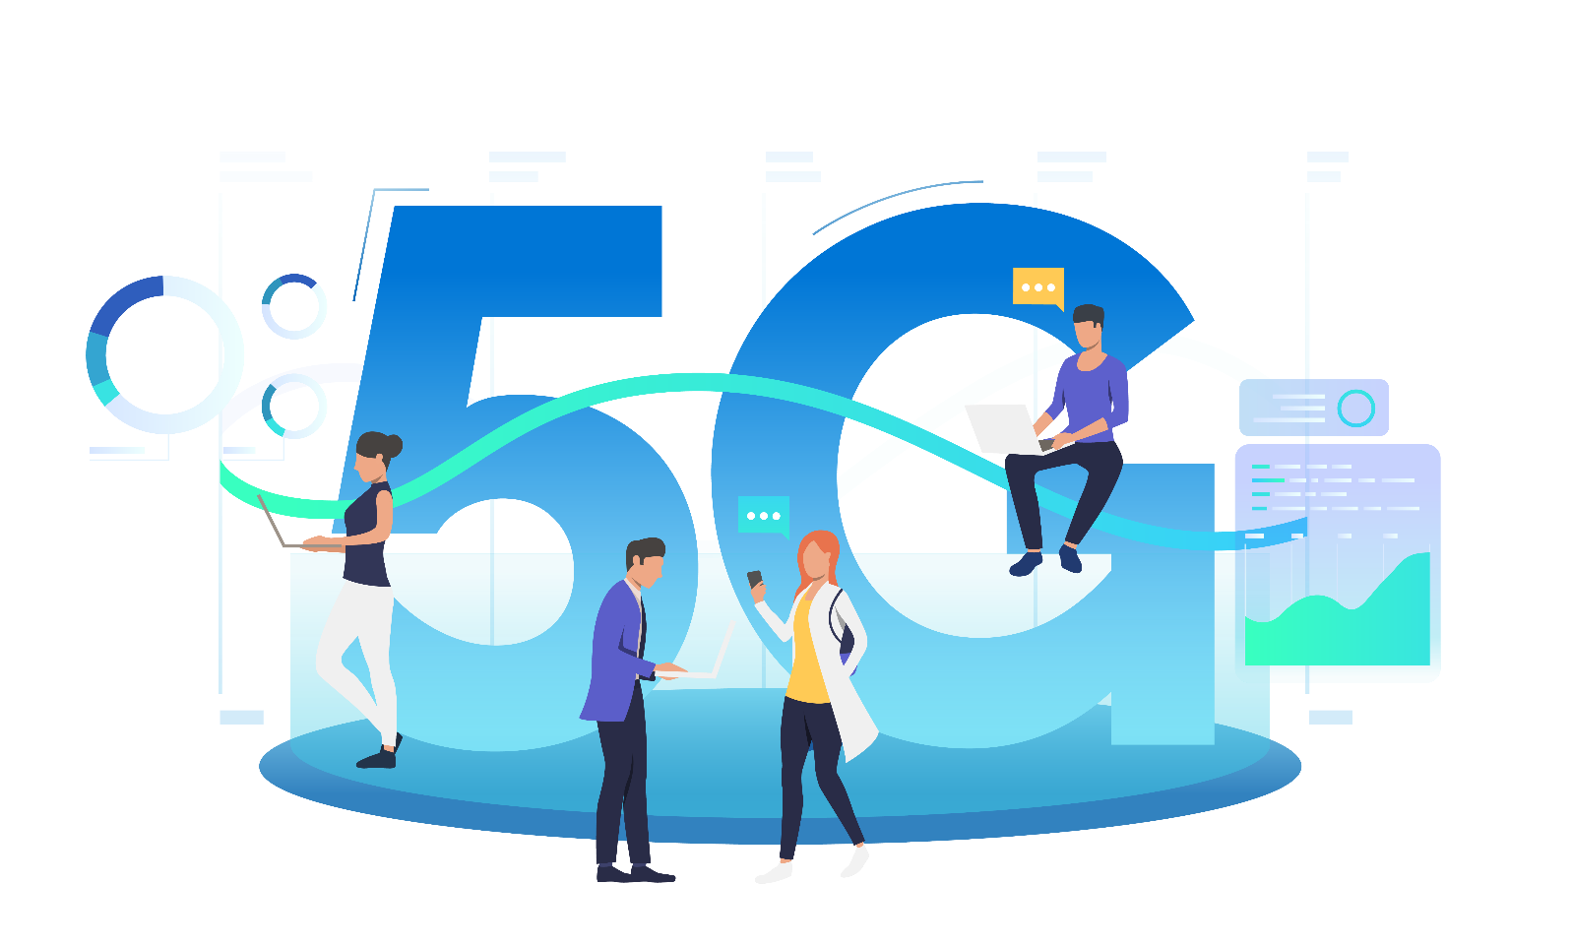
Thank you for your attention.

